Slide 1
Introduction to Web Vulnerabilities and Hardening
Web Vulnerabilities and Hardening
1

Slide 2
Class Objectives
By the end of today’s class, we’ll be able to:
Understand the attack-defend methodology for web vulnerabilities.
Explain how a URL can be manipulated and used to take advantage of web vulnerabilities.
Identify and differentiate between client- and server-side attacks.
Use social media, WHOIS, and Wafw00f to gather information that informs attack options.
Exploit three prevalent web vulnerabilities.

Slide 3

Offense Informs Defense
Throughout this unit, we will act out examples of malicious attacks to show how various hacks and exploits work and how we can better defend against them.
It is important to note that the skills we learn in offensive security units should only be used ethically and with permission.
The actions and intents of criminal hackers, hacktivists and other malicious actors that we mimic for demonstrations are in no way condoned or encouraged.
Notes:
shutterstock_220231387

Slide 4
Intro to Web Vulnerabilities and the OWASP Top 10

Slide 5

The Cyber Kill Chain
Lockheed Martin, an aerospace and defense company, developed another form of layered defense: the cyber kill chain.
lockheedmartin.com

Slide 6

The cyber kill chain is an "intelligence-driven defense framework" designed to identify and prevent cyber intrusions.
Notes:
Image source: shutterstock_1083618569

Slide 7

The Cyber Kill Chain
This framework enhances visibility into an attack by improving a security analyst’s understanding of an adversary’s tactics, techniques, and procedures. It does this by allowing the observation of an attack as it progresses through each stage of the kill chain.
Notes:
shutterstock_1703573218

Slide 8

The Hybrid Kill Chain
A derivative of Lockheed Martin’s cyber kill chain. The hybrid kill chain has been adapted to apply more directly to web server infrastructure.
Notes:
shutterstock_1049969735

Slide 9
The Hybrid Kill Chain
It includes the following stages:
05
Exfiltration Ultimate goal. The exfiltration of private, sensitive data that the target considers critically sensitive.
Reconnaissance Information gathered against a target
01
04
Exploitation Active compromise of adversary’s apps, servers, or network, and averting physical, logical, or administrative controls.
Weaponization Preparation of offensive operations against specific targets using information gathered during reconnaissance.
02
03
Delivery Launch of the operation. Attacks carried out based on Red Team offensive strategies.

Slide 10
The Hybrid Kill Chain
It includes the following stages:
05
Exfiltration Ultimate goal. The exfiltration of private, sensitive data that the target considers critically sensitive.
Reconnaissance Information gathered against a target
01
04
Exploitation Active compromise of adversary’s apps, servers, or network, and averting physical, logical, or administrative controls.
Weaponization Preparation of offensive operations against specific targets using information gathered during reconnaissance.
02
03
Delivery Launch of the operation. Attacks carried out based on Red Team offensive strategies.

Slide 11
The Hybrid Kill Chain
It includes the following stages:
05
Exfiltration Ultimate goal. The exfiltration of private, sensitive data that the target considers critically sensitive.
Reconnaissance Information gathered against a target
01
04
Exploitation Active compromise of adversary’s apps, servers, or network, and averting physical, logical, or administrative controls.
Weaponization Preparation of offensive operations against specific targets using information gathered during reconnaissance.
02
03
Delivery Launch of the operation. Attacks carried out based on Red Team offensive strategies.

Slide 12
The Hybrid Kill Chain
It includes the following stages:
05
Exfiltration Ultimate goal. The exfiltration of private, sensitive data that the target considers critically sensitive.
Reconnaissance Information gathered against a target
01
04
Exploitation Active compromise of adversary’s apps, servers, or network, and averting physical, logical, or administrative controls.
Weaponization Preparation of offensive operations against specific targets using information gathered during reconnaissance.
02
03
Delivery Launch of the operation. Attacks carried out based on Red Team offensive strategies.

Slide 13
The Hybrid Kill Chain
It includes the following stages:
05
Exfiltration Ultimate goal. The exfiltration of private, sensitive data that the target considers critically sensitive.
Reconnaissance Information gathered against a target
01
04
Exploitation Active compromise of adversary’s apps, servers, or network, and averting physical, logical, or administrative controls.
Weaponization Preparation of offensive operations against specific targets using information gathered during reconnaissance.
02
03
Delivery Launch of the operation. Attacks carried out based on Red Team offensive strategies.

Slide 14

Web Vulnerabilities and the Business
Previously we learned that cybersecurity is often considered an obstacle for business operations. This is because enforcing good cybersecurity practices can cause production delays and increase budgets.
14
Notes:
shutterstock_17129131

Slide 15
Web Vulnerabilities and the Business
Results of complacency and relaxed security to maximize profit can include:
01
02
03
A defaced web page containing malicious content or links to inappropriate sites, ultimately damaging a company’s reputation.
A compromised web server used to download malicious software to anyone visiting the webpage.
Compromised data used to commit fraudulent activities, leading to loss of business or lawsuits.

Slide 16
OWASP Top 10
16

Slide 17

The OWASP Top 10 is widely considered to represent the most prevalent security risks facing web applications today.
17
Notes:
Image source: shutterstock_1083618569

Slide 18

OWASP Top 10
Injection
Broken Authentication
Sensitive Data Exposure
XML External Entities (XXE)
Broken Access Controls
Security Misconfigurations
Cross-Site Scripting (XSS)
Insecure Deserialization
Using Components with Known Vulnerabilities
Insufficient Logging and Monitoring
The current list includes:
18

Slide 19

OWASP Top 10
Created to educate software developers, designers, architects, managers, and organizations about the consequences of web application security weaknesses.
19
Notes:
shutterstock_1341289658

Slide 20
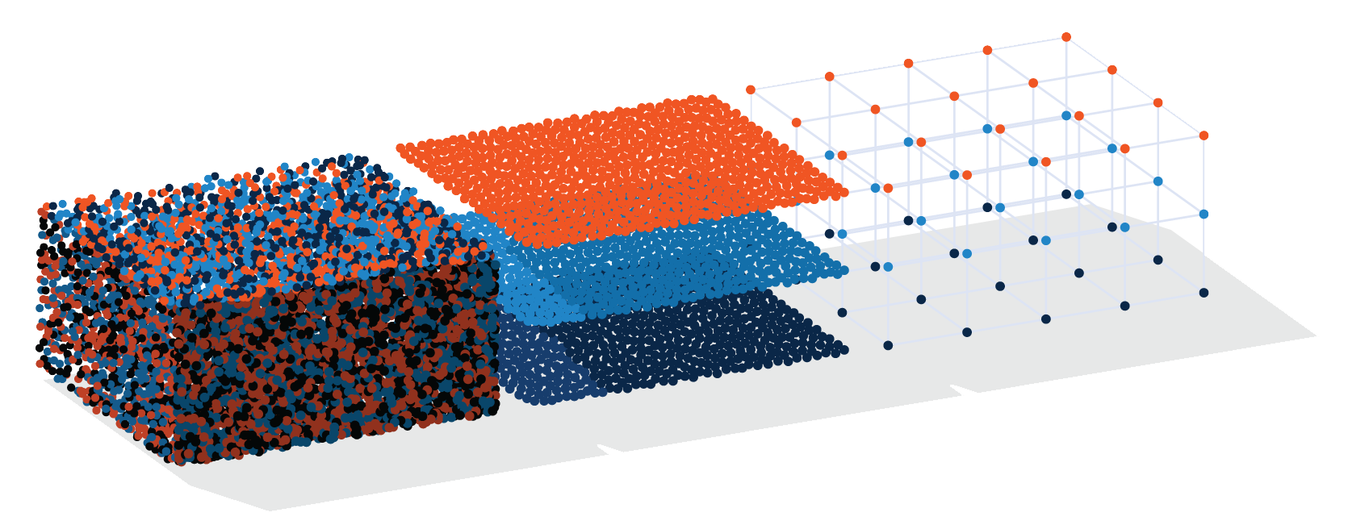
OWASP Top 10
Developed through industry surveys completed by over 500 individuals from hundreds of organizations and over 100,000 real-world applications and APIs.
Notes:
AdobeStock_193515362

Slide 21


OWASP Top 10
Prioritized according to:
Threat level prevalence data
Consensus estimates of exploitability
Detectability
Impact
Notes:
shutterstock_1646473054

Slide 22
The URL Cruise Missile

Slide 23

The first vulnerability we’ll look at is manipulation of the Uniform Resource Locator (URL).
23
Notes:
Image source: shutterstock_499702849

Slide 24
The URL
URLs are the standardized naming convention for addressing documents that are accessible over the internet.
A web address is essentially a unique set of directions to an online resource.
http://example.com/add.asp?item=3478
Host Name
Path
Parameters
Protocol

Slide 25
The URL is the gateway to the web. But the URL can also be used as a weapon to launch attacks.
25
Notes:
Image source: shutterstock_1083618569

Slide 26
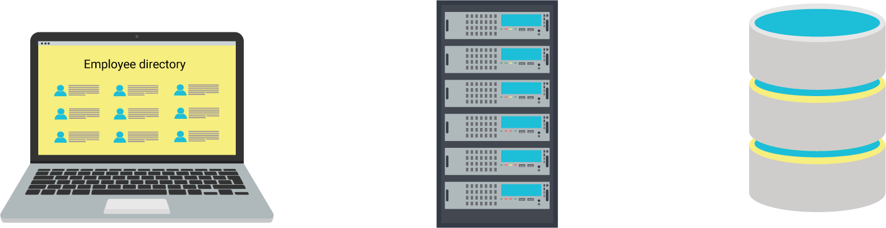
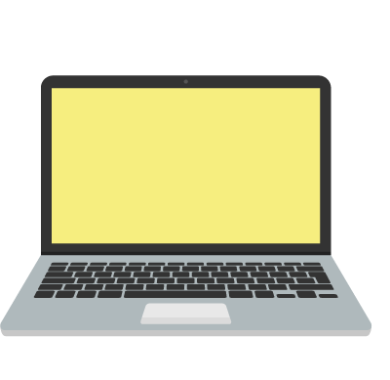

The URL Cruise Missile
The strength of a weaponized URL depends on the web vulnerability that it exploits. The more vulnerable the web client or server, the more dangerous the attack.
http://10.0.0.2/catalogue/display.asp?pg=2&product=13
http:
//
10.0.0.2
/
catalogue
/
display.asp
?
pg=2
&
product=13

Slide 27
The URL Cruise Missile
Various stages of a URL/URI
Protocol | Host Name | Path | Parameters
http:// | www.example.com | /add.asp | ?item=3478

Slide 28
URL Example: Protocol
Protocol indicates the protocol or application to use with the request, such as:
Protocol | Host Name | Path | Parameters
http:// | www.example.com | /add.asp | ?item=3478
HTTP (Hypertext Transfer Protocol) | For transferring web pages
FTP (File Transfer Protocol) | For file transfer requests (upload and download).
SPDY (Speedy) | Google’s version of HTTP, designed to speed up web content loading.

Slide 29
URL Example: Host Name
Host Name identifies a specific web server for the request of web resources:
Protocol | Host Name | Path | Parameters
http:// | www.example.com | /add.asp | ?item=3478
Domain Name | Example.com, google.com, facebook.com, etc.
Sub-Domain | Typically used for a specific subsite within a larger domain. The most common subdomain is www, which stands for world wide web. Some domains use this as an indication of publicly accessible resources and content.

Slide 30
URL Example: Path
Path indicates which web application will provide resources to the client.
Protocol | Host Name | Path | Parameters
http:// | www.example.com | /add.asp | ?item=3478
/add.asp | is a directory, similar to a file or folder on your computer. Many websites, such as retailers, have a long hierarchy of categories such as: /books/non-fiction/computers/tutorials/internet/
.asp Active Server Page | It is a technology that enables designers to produce dynamic and interactive web pages.

Slide 31
URL Example: Parameters
Parameters are specifically formatted data that interact with back-end servers such as email and web databases.
Protocol | Host Name | Path | Parameters
http:// | www.example.com | /add.asp | ?item=3478
?item=3478 | Example of a parameter encoding specific data into the URL for use by the server. In this case, the client-side user is requesting an item with ID 3478.
Each parameter is made up of a few different parts | The question mark (?) indicates the beginning of a list of parameters. Each individual parameter has a name and a value, separated by an equals sign (=). The name of this parameter is item and the value is 3478. A URL can have multiple parameters. These will be separated by an ampersand symbol (&). For example: ?item=3478&price=299

Slide 32
The URL is composed of several different layers designed to access various parts of a website: web pages, emails, or bank account information, for example.
Attackers can exploit weak web server infrastructure to manipulate URLs and infiltrate these various parts of the web server architecture.
32
Notes:
Image source: shutterstock_1083618569

Slide 33
Web Server Infrastructure
33

Slide 34

Web Infrastructure
In the early days of the internet, web pages were mostly static and had long load times. Since then, the internet has made a drastic shift towards user experience, which includes instant response times.
This shift meant visually appealing web applications also had to
be supported.
34

Slide 35

The advancements that have improved user experience for web application users are the same ones that criminal hackers exploit.
In order to harden such systems, security administrators need to have a basic understanding of standard website infrastructure and its sub-components.

Slide 36
Components of Web Infrastructure
Typical web server infrastructure primarily consists of five components.
Client
Firewall
Web Server
Web Application
Database
36

Slide 37
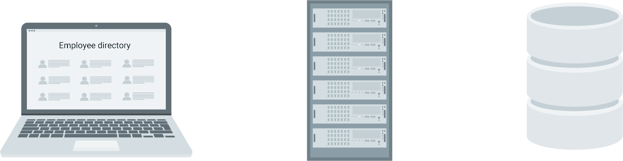
Components of Web Infrastructure: Client
A user who interacts with a web server using HTTP or FTP through either a web browser or file transfer software.
HTTP request
(Cleartext, SQL)
HTTP reply
(HTML, Javascript, etc)
1
2
3
4
5
Web Client
Firewall
Web Server
Ex. Apache, Ngnix, IIS
Web Apps on App server Ex. Perl, C/C++,
Javaserver pages
SQL Database

Slide 38
Components of Web Infrastructure: Firewall
A perimeter defense used to protect the web server sitting behind it.
HTTP request
(Cleartext, SQL)
HTTP reply
(HTML, Javascript, etc)
1
2
3
4
5
Web Client
Firewall
Web Server
Ex. Apache, Ngnix, IIS
Web Apps on App server Ex. Perl, C/C++,
Javaserver pages
SQL Database

Slide 39
Components of Web Infrastructure: Web Server
A program, such as Apache, Nginx, or IIS, that responds to a client's requests for resources.
HTTP request
(Cleartext, SQL)
HTTP reply
(HTML, Javascript, etc)
1
2
3
4
5
Web Client
Firewall
Web Server
Ex. Apache, Ngnix, IIS
Web Apps on App server Ex. Perl, C/C++,
Javaserver pages
SQL Database

Slide 40
Components of Web Infrastructure: Web Application
The software that runs on a remote server, such as Facebook, Twitter, Amazon.
HTTP request
(Cleartext, SQL)
HTTP reply
(HTML, Javascript, etc)
1
2
3
4
5
Web Client
Firewall
Web Server
Ex. Apache, Ngnix, IIS
Web Apps on App server Ex. Perl, C/C++,
Javaserver pages
SQL Database

Slide 41
Components of Web Infrastructure: Database
Typically the innermost part of the web architecture, storing data like customer names, addresses, account numbers, and credit card info.
HTTP request
(Cleartext, SQL)
HTTP reply
(HTML, Javascript, etc)
1
2
3
4
5
Web Client
Firewall
Web Server
Ex. Apache, Ngnix, IIS
Web Apps on App server Ex. Perl, C/C++,
Javaserver pages
SQL Database

Slide 42
Web Infrastructure Security
Securing web infrastructure includes some of the following processes:
Input Sanitation
Input Validation
Secure Software Deployment Cycles (SDLC)
The process of cleansing and scrubbing user input in order to prevent it from exploiting security holes. This is ensured by, when necessary, changing the value input by the user.
The testing of input supplied by a user or application, designed to prevent malformed data from entering a data information system. This is done by verifying user input meets specific criteria.
A software development methodology that ensures secure programming occurs at every stage of the software development process.
42

Slide 43
Web Vulnerabilities
SDLC faces the following challenges, giving way to vulnerabilities:
High Implementation costs
Insufficient support from management
Insufficient standardization
No quality management
Reactive security postures (If it ain’t broke, don’t fix it)
Total reliance on web application firewalls
43

Slide 44
Popular Web Servers and Associated Vulnerabilities
Internet Information Server (IIS) is a general-purpose web server from Microsoft that runs on Windows systems and serves HTML pages and files to web clients.
Associated Web Vulnerability | Description | National Vulnerability Database Reference
Cross-Site Scripting (XSS) | Allows remote attackers to alter a URL with a malicious script that will redirect a message or request. | CVE-2003-0223
Directory Traversal | Allows remote attackers to view source code and determine the existence of arbitrary files via a hex-encoded %c0%ae%c0%ae string, which is the Unicode representation for ".." (dot dot). | CVE-2002-1744
Denial of Service | Buffer overflow of the data transfer mechanism in IIS allows remote attackers to cause a denial of service or execute code. | CVE-2002-0147
44

Slide 45
Popular Web Servers and Associated Vulnerabilities
Apache is an open source web server alternative that runs on UNIX, Linux, and Windows.
Associated Web Vulnerability | Description | National Vulnerability Database Reference
OpenMeetings SQL Injection | Allows for modification of the structure of existing queries, resulting in the exfiltration of queries being made by the back-end application. | CVE-2017-7681
Apache Ranger Security Bypass | Any characters after a wildcard symbol (*) is ignored, resulting in unintended behavior. | CVE-2017-7676
Apache HTTP Server Authentication Bypass | The use of the string ap_get_basic_auth_pw() by third-party modules can bypass authentication requirements. | CVE-2017-3167
45

Slide 46
Popular Web Servers and Associated Vulnerabilities
Nginx is an open-source, less popular alternative to Apache that runs on Linux.
Associated Web Vulnerability | Description | National Vulnerability Database Reference
Nginx SPDY Heap Buffer Overflow | Allows remote attackers to craft requests that execute arbitrary code. | CVE-2014-0133
Nginx Root Privilege Escalation Vulnerability | Allows local users to gain root privileges. | CVE-2016-1247
Remote Integer Overflow Vulnerability | Sensitive data can be leaked with crafted requests that exploit a range filter module in certain Nginx versions. | CVE-2017-7529
46

Slide 47
Activity: URL Cruise Missile
In this activity, you will strengthen your knowledge of concepts related to the URL to understand how the URL can be manipulated to act as a weapon against web server infrastructure.
15 Minutes
47

Slide 48
48

Slide 49
Client-Side and Server-Side
Attacks
49

Slide 50


In today’s globally connected cyber community, network- and OS-level attacks are well defended through the proper deployment of technical security controls like firewalls, IDS, data loss prevention, and endpoint security.
However, web servers are accessible from anywhere on the web, making them vulnerable to attack.
50
Notes:
Image source: shutterstock_1373567648

Slide 51
Client and Server Response Refresher
How responses and requests travel through web infrastructure:
01
Client: A user generates an HTTP request from their web browser using a URL or web address, such as: http://example.com/add.asp?ItemID=123&Price=999
02
Web Server: The user’s HTTP request arrives at the front-end web server as directed by the domain and processes the following portion the URL. (http://example.com)
03
Web Application: The user’s HTTP request invokes the application service from the application server as directed by the path. (/add.asp)
04
Database Server: The user’s HTTP request invokes the database server and performs a query in search of a specific item number and its price. (?ItemID=123&Price=999)
51

Slide 52
Client-Side and Server-Side Attacks
Client-side attacks
Server-side attacks
Target software installed on the desktop, such as web browsers, email clients, media players, and office suites.
Seek to compromise and breach applications and data on a server.
52

Slide 53
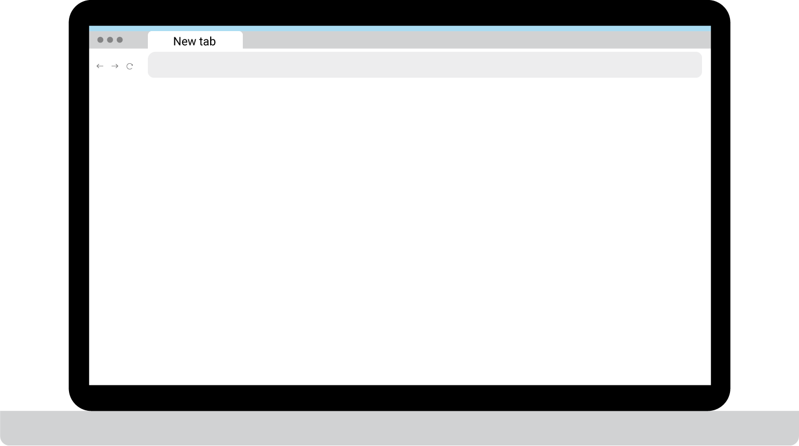
Client-Side
Web browsers are how users access the world. As such, represent an attractive and easy target for criminal hackers.
A client-side attack occurs when a user’s computer downloads malicious content from the web. Client-side attacks can be difficult to mitigate if companies allow internet access to:
Word processing software
Web browsers
Spreadsheets
Email clients
Media players
File transfer clients
53

Slide 54

Prevalent Client Side Attacks
Firewalls often fail to prevent client-side attacks, which occur behind the firewall and from within the local network.
Cross-site scripting (XSS) allows attackers to inject malicious code into a website in order to intercept user sessions, vandalize websites, steal data, and control a user's browser.
54
Notes:
Image source: shutterstock_1335132566

Slide 55



Prevalent Client Side Attacks
Firewalls often fail to prevent client-side attacks, which occur behind the firewall and from within the local network.
Clickjacking tricks users into clicking misleading graphics that will then trigger an exploit.
For example: A big fake Download button.
55
Notes:
Image source: Shutterstock_1520238332, shutterstock_1030846396, shutterstock_63149626

Slide 56
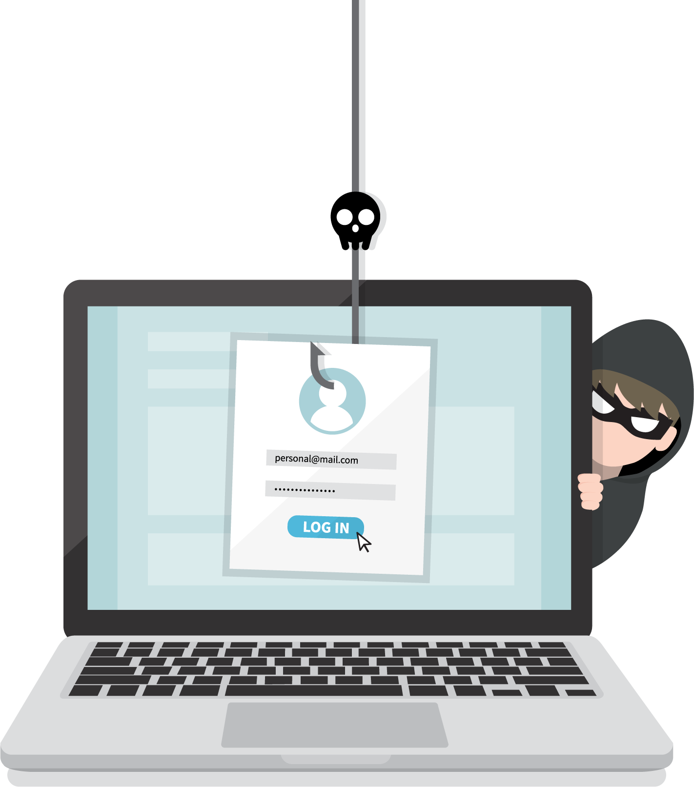
Prevalent Client Side Attacks
Firewalls often fail to prevent client-side attacks, which occur behind the firewall and from within the local network.
Content Spoofing tricks a user into believing that a certain website is legitimate. For example, a fake social media login page that steals your credentials after you submit them.
56
Notes:
Image source: shutterstock_1519115729

Slide 57

Prevalent Client Side Attacks
Firewalls often fail to prevent client-side attacks, which occur behind the firewall and from within the local network.
Drive-By Download are downloads triggered without the users knowledge upon visiting a webpage.
57

Slide 58

Prevalent Client Side Attacks
Firewalls often fail to prevent client-side attacks, which occur behind the firewall and from within the local network.
Phishing is a form of social engineering that manipulates a computer user into providing personal confidential information, such as user credentials and bank account information.
58
Notes:
Image source: Shutterstock_1192368955

Slide 59
Server-Side Attacks
Attackers typically target the following software vulnerabilities and configuration errors in order to compromise a web server:
Default accounts that contain easily acquired default usernames and passwords.
Misconfigurations within a web server, web app, network, or operating system.
Bugs in a web server from unpatched systems.
Unnecessary services that lead to a larger attack service.
Default settings on installed web server and apps that remain unchanged.
Security conflicts with business cases and lack of budget.
Improper permissions allowing overly lenient access to directory and file permissions.
59

Slide 60
Prevalent Server-Side Attacks
Website Defacement
HTTP Response Splitting
Web Cache Poisoning
Parameter or URL Tampering
Path or Directory Traversal (dot-dot-slash attack)
An attack against a website that alters its appearance or the information it contains.
The server does not properly sanitize input values, such as character returns (CRs) and line feeds (LFs), allowing for attacks such as cross-site scripting.
Involves replacing legitimate cached web pages with malicious content.
Manipulation of parameters in a URL passed to a web server.
Used to navigate into files and directories with dot-dot-slash (../) as if navigating through directories in a terminal, with the aim of reaching folders outside of the root directory.
60

Slide 61
Risk Mitigation: Input sanitization
Web application (preferably server-side) actively modifies user input to an acceptable format or blocks the user’s request.
Application
Validator
Input()
Sanitized Input()

Slide 62
Risk Mitigation: Input validation
Checks that user input is in an acceptable format.
Password Verification
Username:
ghopkins6793@hotmail.com
Password:
•••••••••••••••••••••••
Password must contain the following: ✓ At least one letter
X At least one capital letter
✓ At least one number
X Be at least 8 characters

Slide 63
Activity: Client vs. Server Side Attacks
In this activity, you will explore the differences between client- and server-side attacks.
15 Minutes
63

Slide 64
64

Slide 65

Notes:
Image source: AdobeStock_56885471
Break

Slide 66
Reconnaissance and Information Gathering
66

Slide 67
The Hybrid Kill Chain
It includes the following stages:
05
Exfiltration Ultimate goal. The exfiltration of private, sensitive data that the target considers critically sensitive.
Reconnaissance Information gathered against a target
01
04
Exploitation Active compromise of adversary’s apps, servers, or network, and averting physical, logical, or administrative controls.
Weaponization Preparation of offensive operations against specific targets using information gathered during reconnaissance.
02
03
Delivery Launch of the operation. Attacks carried out based on Red Team offensive strategies.

Slide 68


Reconnaissance
Facebook is the most popular online social media platform used today. It can be thought of as an information wholesaler, making it incredibly desirable to attackers.
Notes:
Image source: shutterstock__1160579752

Slide 69
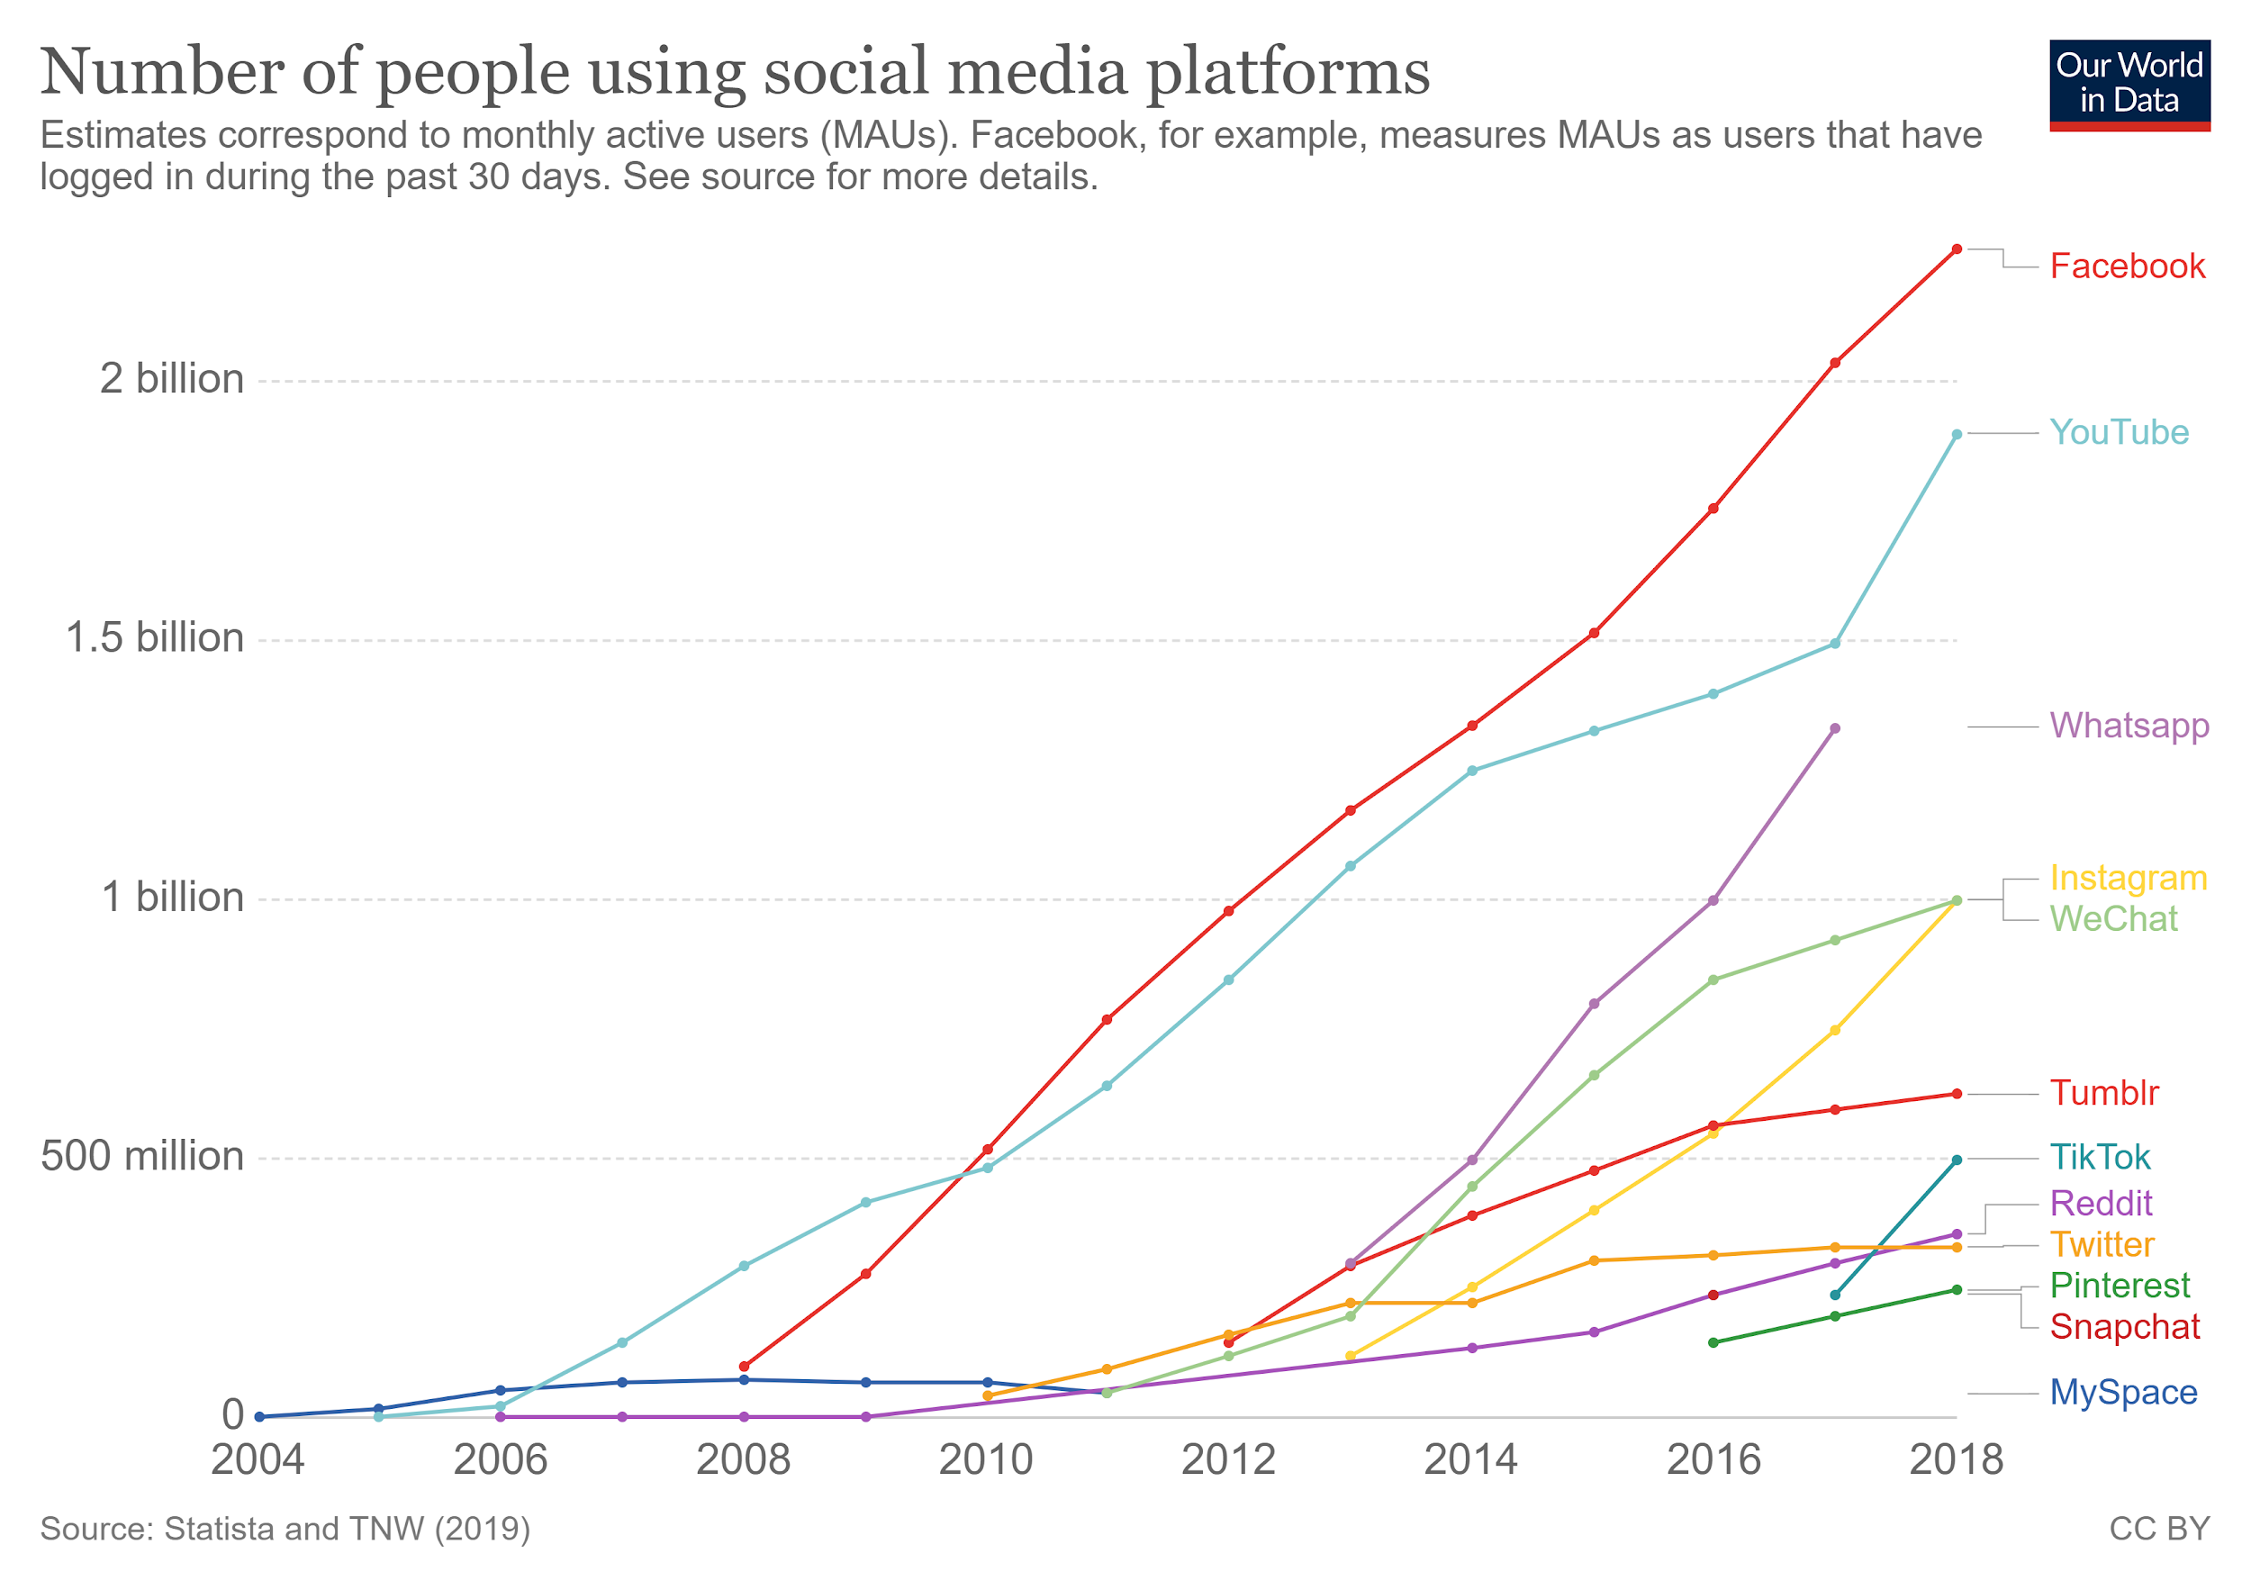

Reconnaissance
While not on the list, LinkedIn and its 500+ million users provide a wealth of information that can be used against employers and companies.
69
Notes:
https://ourworldindata.org/grapher/users-by-social-media-platform

Slide 70






Reconnaissance
Social media has proven a profitable and effective way to build communities and engage customers. But to securely operate social media accounts, businesses must train employees to ensure they do not:
Engage with suspicious posts. | Share passwords. | Click on ads. | Use social media on public Wifi. | Use the same password for extended periods of time. | Follow accounts or people you don’t know or haven’t vetted.
70
Notes:
shutterstock_648976426

Slide 71

Social Engineering
The attack surface is amplified for attackers who cross-reference information gathered from LinkedIn and Facebook, allowing them to carry out various social engineering attacks.
LinkedIn
Facebook
Types of hardware and software
used by a company
First and last names of employees
Employee position information
Length of employment
Prior work history
Education
Skills and endorsements
Previous projects
Names of friends and family
Favorite hobbies
Vacation spots
Favorite books and movies
Favorite foods, drinks and restaurants
71

Slide 72
Hackers also use more advanced forms of information gathering.
72
Notes:
Image source: shutterstock_1083618569

Slide 73

Web crawlers
Web crawlers, also known as spiders and spiderbots, index sites to help search engines find content.
73
Notes:
Image source: shutterstock__710214691

Slide 74
Web crawlers: robots.txt file
01
02
03
To hide information from web crawlers, such as sensitive web server information, website owners can use the robots.txt file.
But excluding directories and pages indicates that they likely contain critical, sensitive data. This makes them attractive targets.
Experienced criminal hackers will attempt to harvest the robots.txt file to retrieve private data, such as content management system information and root directory structure.

Slide 75

robots.txt
A bot wants to visit the following URL: http://www.example.com/welcome.html
Prior to visiting the URL, it first checks http://www.example.com/robots.txt
It might receive any of the following responses:
User-agent: *
Disallow: / Excludes all bots (indicated by the * wildcard symbol) from the entire server as indicated by disallowing access to the / root directory
User-agent: *
Disallow: /cgi-bin/
Disallow: /tmp/
Disallow: /user/ Excludes all bots from specific directories.
User-agent: BadBot
Disallow: / Excludes a single bot (BadBot) from the entire server.
75
Notes:
Image source: shutterstock__715962319

Slide 76
Bots
Two important security implications that organizations must consider when using /robots.txt files:
01
Malicious Bots
02
“Don’t Look Here!”
Bots can ignore your robots.txt file. Especially malware robots, which scan the web searching for security vulnerabilities.
robots.txt is available to the public.
Be aware that files that have been disallowed may be seen as opportunities to find important sensitive data. Otherwise they wouldn’t have been disallowed in the first place.
76

Slide 77

WHOIS
Another effective reconnaissance tool is the WHOIS protocol.
WHOIS is a query and response protocol used for querying the WHOIS database.
As you may recall from earlier units, a WHOIS database stores registered user information including IP address blocks, domain names, email and street addresses, and phone numbers.
77
Notes:
Image source: shutterstock_534512839

Slide 78

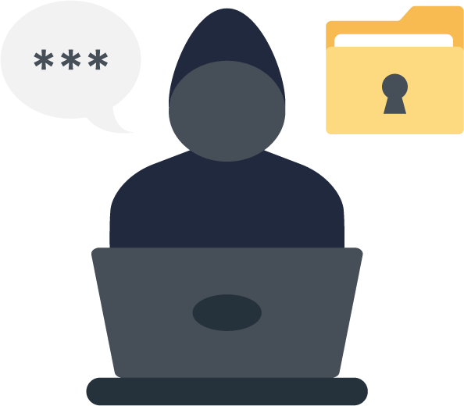

Whois Demo
We’ll demonstrate using the WHOIS database with the following scenario:
A hacktivist is trying to infiltrate the local newspaper’s network, The Sacramento Bee, in order to deface their home web page.
The hacktivist is upset about a recently published op-ed article that favors a view they oppose.
They’ve decided to produce a phishing email to collect personal data from the newspaper's website registrant by falsely stating that their domain name
will be taken offline due to non-payment.
We will use a WHOIS registration database query to find registered user information, such as emails and phone numbers.
78
Notes:
Image source: shutterstock_1127740046, shutterstock_395437312, shutterstock_1080156761

Slide 79
WHOIS Database
79

Slide 80

Web Application Firewalls
Web application firewalls (WAFs) are designed to defend against different types of HTTP attacks and various query types, such as SQLi and XSS.
Common request
200 OK
Common request
Client
200 OK
Attack request
Web application
Web application firewall
403 Forbidden
Attacker
80
Notes:
Image source: shutterstock_1661956288

Slide 81
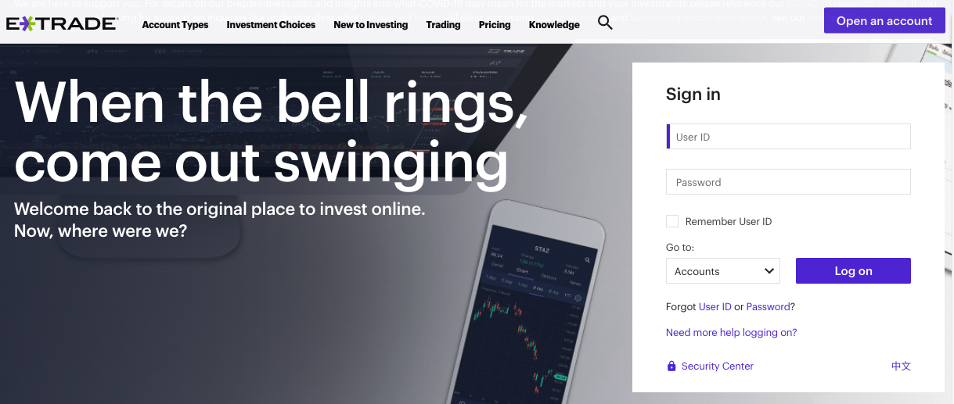
Web Application Firewalls
WAFs are typically present on web sites that use strict transport security mechanisms, such as online banking or ecommerce websites.
etrade.com

Slide 82
WAFs can provide adversaries crucial information regarding the security posture of an organization’s web infrastructure.
82
Notes:
Image source: shutterstock_1083618569

Slide 83
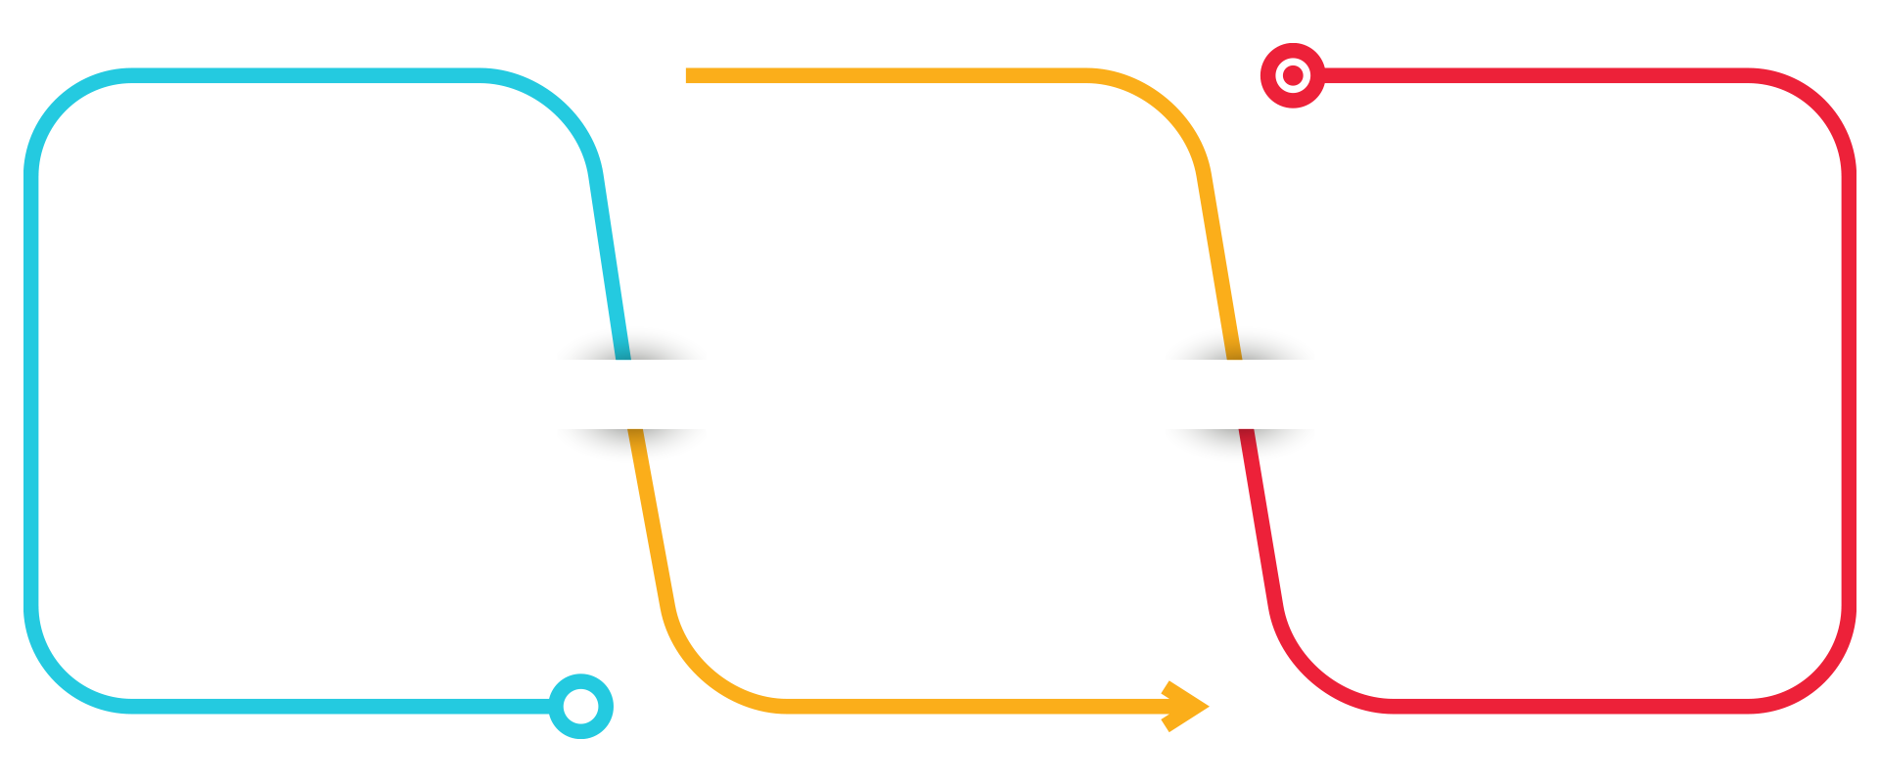
WAF Deployment
WAFs have three deployment strategies, each with their own sets of advantages and disadvantages.
Network-Based WAFs
Host-Based WAFs
Cloud-Based WAFs
Low-latency hardware installed locally on-premises with dedicated appliance.
Large-scale deployment and configuration management capabilities.
High-cost, with initial expenses to set up, and ongoing operational costs.
Software-based and dependent on local server resources.
Low cost, subscription based, turnkey products that require minimal resources.
Enables application protection across a broad spectrum of hosting locations.
Cloud service providers use the most current threat intelligence to help identify and block new application security threats.
83
Notes:
Image source: shutterstock_1135646558

Slide 84
WAF Analysis and Filtering
WAFs analyze and filter traffic based on three different techniques:
01
Allow lists
02
Deny lists
03
Hybrid
Only accepts traffic from
sources that are known and trusted.
Less-resource intensive than deny lists.
May block benign traffic unintentionally.
Uses preset signatures to block malicious web traffic.
Useful for public websites and web applications that receive lots of traffic from unknown IP addresses.
Resource-intensive due to packet filtering based on a set of specific characteristics as opposed to IP addresses.
Uses a combination of allow and deny lists.
84

Slide 85
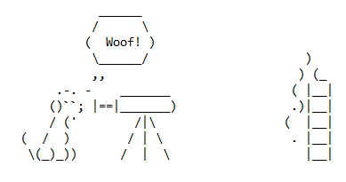
Wafw00f
Wafw00f is an open source command-line WAF utility focused on web-based attacks that occur at the application layer.afw00f
github.com
Notes:
https://github.com/EnableSecurity/wafw00f

Slide 86

Wafw00f
01
Python
02
Vulnerabilities
It is written in Python and automates a carefully crafted set of procedures to determine if a website sits behind a web application firewall.
Although WAFs are used to harden web server infrastructure, they do come with vulnerabilities of their own.

Slide 87

Wafw00f Demonstration
We’ll demonstrate Wafw00f using the following scenario:
You’re a criminal hacker looking to exploit any web vulnerability on a web site.
Before you can launch an attack, you need to know if the website is protected by a web application firewall and if so, what kind.
The results of this information gathering process will indicate the types of attacks that are available to you.
87
Notes:
Image source: shutterstock_1681512961

Slide 88
Wafw00f Database
88

Slide 89
Activity: Information Supermarket
In this activity, you will research how to mitigate data sourcing from web vulnerabilities that resulted in a surge of social engineering attacks.
15 Minutes
89

Slide 90
90

Slide 91
Executing Attacks
91

Slide 92
Stage 2: Execution
Now we will pivot from reconnaissance to the weaponization stage of the hybrid kill chain
05
Exfiltration Ultimate goal. The exfiltration of private, sensitive data that the target considers critically sensitive.
Reconnaissance Information gathered against a target
01
04
Exploitation Active compromise of adversary’s apps, servers, or network, and averting physical, logical, or administrative controls.
Weaponization Preparation of offensive operations against specific targets using information gathered during reconnaissance.
02
03
Delivery Launch of the operation. Attacks carried out based on Red Team offensive strategies.

Slide 93
Stage 2: Execution
By performing three specific attacks prevalent in today’s cyber community:
01
02
03
Parameter tampering
Directory traversal
Cross-site scripting

Slide 94

Parameter Tampering
Parameter tampering is a web-based attack in which specific URL parameters or webpage form field data is modified from its original state.
Attackers use parameter tampering to take advantage of web vulnerabilities resulting from insecure web programming. This attack is used to obtain private personal or business information.
94
Notes:
shutterstock_664284316

Slide 95


Parameter Tampering Demo Setup
We’ll demonstrate how to execute a parameter tampering attack with the following scenario:
You visited a webpage of a major online retailer looking to buy a new laptop.
You found the perfect laptop but cannot afford the price tag of $1,999.00.
You’ve decided to take advantage of a potential web vulnerability and change the sales price of the laptop by altering a form field on the webpage.
95
Notes:
Image source: shutterstock_95615701

Slide 96
Parameter Tampering
96

Slide 97
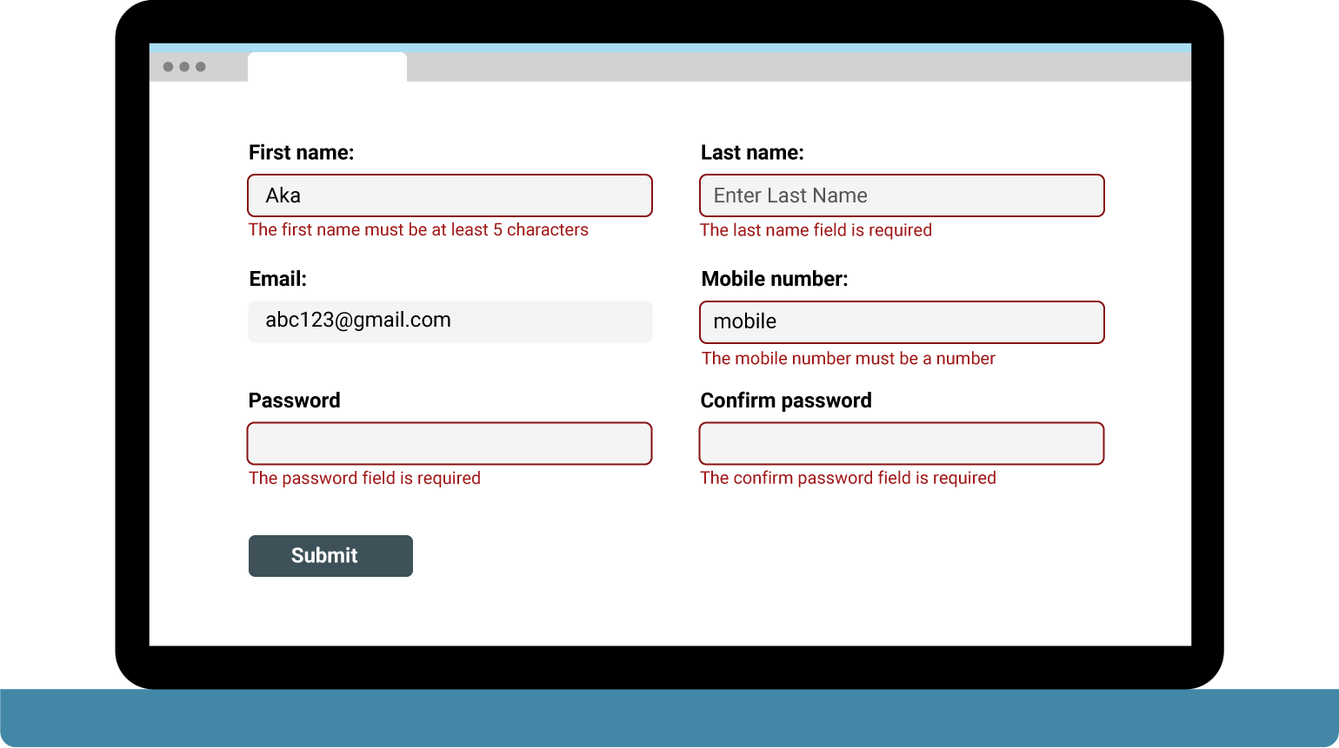
Parameter Tampering Hardening
While less common today, this web vulnerability results from a lack of input validation.
Input validation is the process of testing the supplied input of a user or program, which detects and prevents improperly formatted data from entering an information system.
Additional mitigation strategies include:
Restricted numeric range
Restricted character sequence and patterns
Restricted use of null
Restricted parameter use of unused form fields
97

Slide 98

Path/Directory Traversal
Path traversal is an attack that exploits web vulnerabilities by referencing files with a dot-dot-slash (../) sequence in the URL.
A vulnerable web server can allow an attacker to access arbitrary files and directories stored on a web server. This can result in the loss of application source code, system configuration information, and/or critical system files.
98
Notes:
shutterstock_1684873624

Slide 99
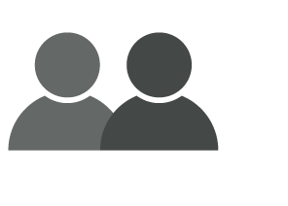
Path Traversal Demo Setup
We’ll demonstrate how to execute a path traversal attack with the following scenario:
You’re a hacktivist who’s politically motivated to shame an organization with opposing views.
You’ve decided to hack into the opposition groups email server with and make private emails publicly available. To carry out this mission, you must harvest a list of all users.
You will attempt to exploit a possible web vulnerability by using path traversal.
99
Notes:
Image source: shutterstock_95615701

Slide 100
Path Traversal
100

Slide 101
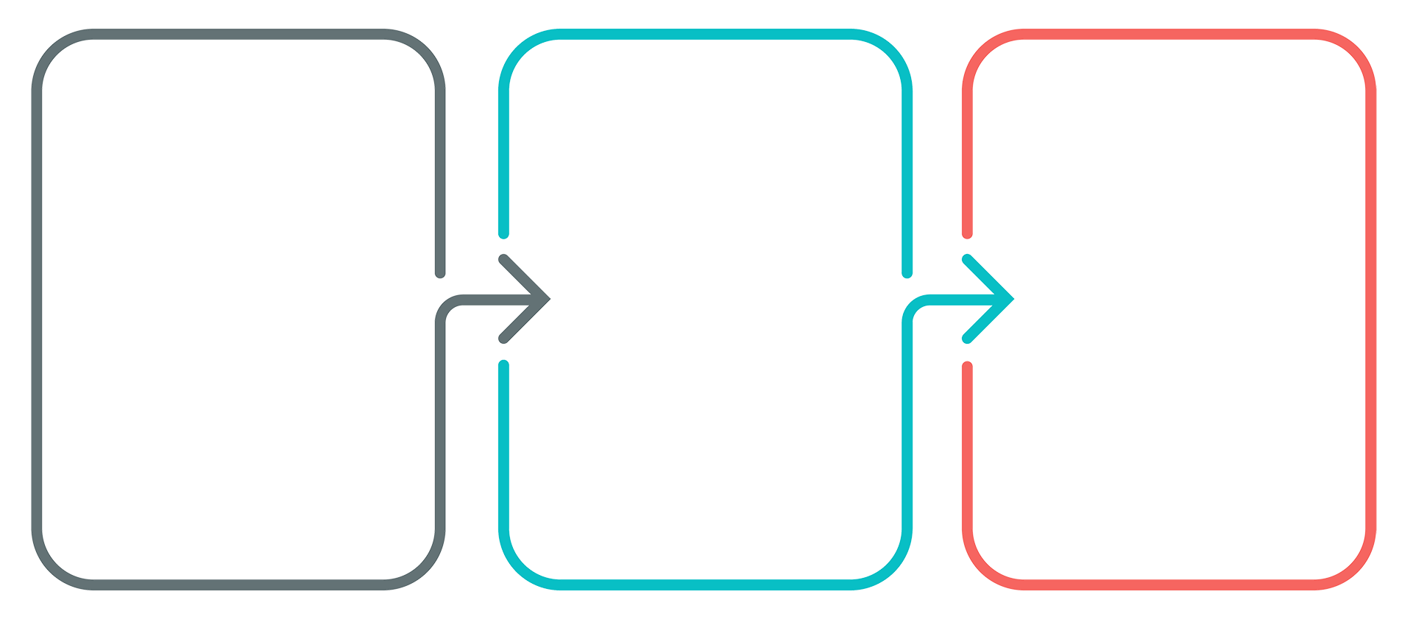
Path Traversal Mitigation
Path traversal is usually the result of a lack of input validation.
Input validation is the primary defense mechanism. The same rules apply as discussed in the parameter tampering exercise.
Ensure that all files and folders on the local server have proper access controls in place through system hardening.
Web developers should avoid storing private sensitive information in the web root directory.
101

Slide 102

Cross-Site Scripting (XSS)
Cross-site scripting (XSS) attacks occur when an attacker takes advantage of a web vulnerability by injecting malicious code into a web browser that’s stored on the back-end server. This is typically in the form of a script, which then affects subsequent visitors to that same web page.
An end user’s browser doesn’t have the capability to detect such attacks because of the default trust relationship it has with the source.
As a result, the affected end user’s web browser allows the malicious script free access to session tokens, cookies, and any other sensitive information stored by the browser.
102
Notes:
shutterstock_435603700

Slide 103

XSS Demo Setup
We’ll demonstrate how to execute a cross-site scripting attack with the following scenario:
You’re a criminal hacker whose mission is to gain root access to a web server.
Before you can do that, you need to steal a session cookie.
You will perform a cross-site scripting attack, but first will need to determine if the attack is possible.
103
Notes:
Image source: shutterstock_95615701

Slide 104
Cross-Site Scripting
104

Slide 105

XSS Mitigation
Mitigation strategies include:
Data Output Encoding: Encodes user-controlled data before its output in an HTTP response. This prevents it from being misinterpreted as active content.
Data Input Filters: Filters data at the point where user input is received, based on expected or valid input criteria.
Content Security Policy (CSP): Detects and mitigates specific types of attacks, including XSS and other injection attacks. (Not all browsers support CSP.)
105

Slide 106
Activity: Executing Exploits
In this activity, you will use OWASP’s Broken Web Apps to demonstrate the various ways a website can be exploited.
20 Minutes

Slide 107
107

